Slide 1
World Water Day
WaterAid/ Habibul Haque
Presented by:

Slide 2
World Water Day was founded by the United Nations.
It is an observance day that highlights the importance of clean water and raise awareness of the water crisis around the world
Notes:
World Water Day was founded by the United Nations in 1992
It is an observance day that highlights the importance of clean water and raise awareness of the water crisis around the world.

Slide 3
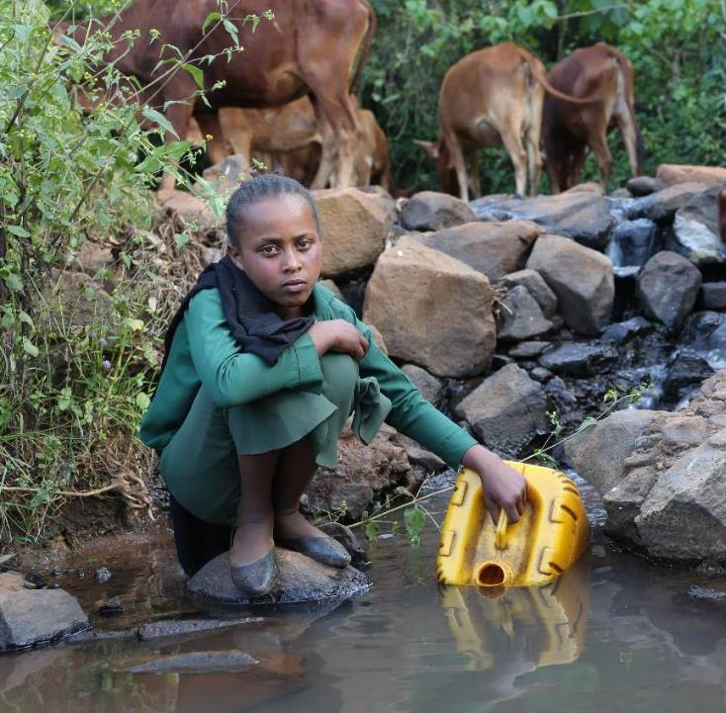
Let’s talk about water
“Collecting water is the chore I hate the most”
“I have to collect water at least three times a day”
“I have to walk up the hill with the heavy jerry can on my back”
“We need at least 10 jerry cans between our animals and us.”
Mulu, aged 10, Ethiopia
WaterAid/ Behailu Shiferaw
Notes:
Imagine if you had to walk long distances to collect water for your family each day
Mulu, 10, collects water from a nearby river in West Shoa, Ethiopia. Mulu told us:
“Collecting water is the chore I hate the most. Yet, I have to do it at least three times a day – before school, right after school and just before it gets too dark. The river is down there, in the valley, which means I have to walk up the hill with the heavy jerry can on my back. As I leave the house to go to the river, I already think about how tired I am going to be by the time I get back home. It leaves me with a pain in my chest and my shoulder where the strap rests. But I know my family needs the water. We need at least 10 jerry cans between our animals and us. So I have to fetch at least some of it to help my mother.”
For many people, walking long distances each day just to collect water is a reality, which is often the responsibility of women and girls.
The problem is not only the weight of the water and the time spent collecting it, but where it comes from. Often, the only source of water for people living in the world’s poorest communities is a pond or river.
Imagine if your water was also being used by animals, as well as hundreds of other people for their daily activities, such as washing and bathing. Water like this can be full of the germs that spread diseases.

Slide 4
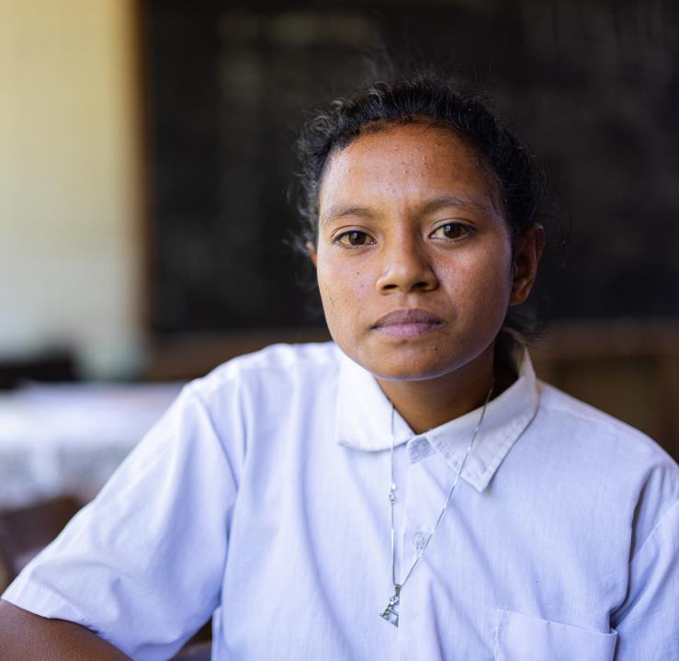
“I think that if there was water in the house or in the school I wouldn’t need to go to the river for washing”
Cris, 16, Timor-Leste
WaterAid/ Laura Summerton
WaterAid/ Habibul Haque
Notes:
Cris, 16 years old from Lesuata, Timor-Leste.
Cristina is 16 years old, and likes to be called Cris.
She had six siblings, but two have passed away.
She now has two brothers and two sisters. She is the youngest sibling.
At Cris’s school students and teachers collect water to use in the toilets and for washing hands but when not everyone is able to do so there is not enough to stay clean. In the rainy season, Cris’s community is able to collect water in rain tanks but in the dry season limited water resources mean these can’t be used.
In the dry season, Cris and other girls often miss school when they have their period because they walk a one hour round trip to clean themselves, All the girls in Lesuata are forced to make this journey.
If there was water at home or at school the girls wouldn’t need to go to the river for washing. During the dry season many of the girls in the community are forced to walk to the river in order to stay clean. Children spends hours collecting water when they should be at school. Many children like Cris have to make exhausting journeys for water. Even if they get to school, they are often too tired to concentrate. When a girl gets her period, she often leaves school because she can’t keep herself clean. All this means children—especially girls—miss out on the education they really need.
Around the world, three in ten schools don’t have clean water and one in three don’t have decent toilets. This exposes millions of children and teachers to deadly diseases caused by drinking dirty water and going to the toilet in the open. It denies young people their education and their dignity.
This shouldn’t be normal. Change is needed, and we can make it happen.
Through the work of WaterAid we work alongside communities and build decent toilets, hygiene facilities and teach the students about the benefits of good hygiene. Together we are helping children to keep learning by building toilet blocks, by teaching them good hygiene through health clubs. Cris has big dreams “When I finish school I want to continue my studies and to get a job.”
With clean water and decent toilets, Cris can reach for her dream.

Slide 5
Let’s talk about water
million people don’t have clean water close to home
That is 1 in 10 people in the world.
Notes:
Film link: https://youtu.be/GluchjVKFro
Wherever you are in the world, it’s the poorest and least powerful who are most often without clean water: those who are older, ill, disabled, living in remote or rural locations or displaced, of a different caste or ethnicity or religion, or in informal or illegal settlements. Water will transform their lives.
771 million people around the world still don’t have access to water close to home. (WHO/UNICEF (2021) Progress on household drinking water, sanitation and hygiene 2000-2020. Joint Monitoring Programme. Geneva: World Health Organisation. See: JMP website)
Without clean water, people are denied access to opportunities that should be open to everyone, everywhere.
Whole communities are held back while others thrive, simply because they don’t have access to clean water.
That’s 1 in 10 people around the world without clean water close to home. (within 500 metres or a 30- minute walk). (WHO/UNICEF (2021) Progress on household drinking water, sanitation and hygiene 2000-2020. Joint Monitoring Programme. Geneva: World Health Organisation. See: JMP website)

Slide 6
Why is water so important?
Livelihood
Education
Health
Life
Time
Dignity
Notes:
Why is water so important?
Can you think of a time when you have needed some water (for a drink, to clean your hands after the toilet) but none was available?
How did you feel and what did you do?
Water is so important as it can impact your life in so many ways:
Health: Having clean water close by saves lives. For example it can help babies make it through their vulnerable first five years, give new mums the best chance of survival, and give everyone a fighting chance of avoiding waterborne diseases.
Livelihoods: Clean water gives people the time and resources to find jobs, learn new skills and run successful businesses. It helps them break free from poverty and change their lives for good.
Time: In most countries, the burden of collecting water falls mainly on girls and women. But when they only need to carry it a few steps from the nearest tap and that time is freed up, giving girls the chance to play and go to school, and enabling women to work and look after their families.
Education: Spending time in the classroom is something many children can only dream of. When they no longer have to collect water every day, that dream can come true – opening up a world of opportunities.
Dignity: Clean water is something so many of us take for granted. But being able to wash regularly in a clean, private place is essential to lead a dignified life.
Life: WaterAid never get tired of talking about water. Why? Because, quite simply, we can’t live without it. And because, every day, we get to hear incredible stories showing how water is enabling people to unlock their potential and transform their lives. Forever.

Slide 7
Why are people without access to clean water?
Poverty – they have limited money available
Governments prioritise other areas
Their environment – droughts, flooding and climate change
They live far from a water source
Political instability, conflict and displacement
Notes:
Why are people without access to clean water? There are a mixture of reasons:
Poverty – they have limited money available
Governments prioritising other areas to spend money on
Environment
Long distance from a water source
Political instability, conflict and displacement
More details:
Governments may let water get left behind while focusing on other important priorities, like industry, roads, schools and hospitals.
Many people live in countries where the national economy is too poor to create water infrastructure at the scale they need. Construction can also be difficult in many places because of extreme geography – like deserts, mountains and jungle – and not enough trained experts who know how to find long-term solutions.
Vulnerable people in society are affected most by this lack of clean water. Those living in hard-to-reach areas can be forgotten entirely, poor people can be priced out, and groups perceived as different can be denied access to them. We work with these communities to help them claim their rights to clean water.
People’s access to water can also be affected by drought and climate change.

Slide 8
Notes:
WaterAid believes WASH are human rights. There are power imbalances in the world which means people (the poorest and most marginalised) are having their human rights denied to them. WaterAid has a rights -based approach, so everyone everywhere can access their rights to WASH.
The right to water entitles everyone to sufficient, safe, acceptable, physically accessible and affordable water for personal and domestic use.
The right to sanitation entitles everyone to sanitation services that provide privacy and ensure dignity, and that are physically accessible, affordable, safe, hygienic, secure, and socially and culturally acceptable.
The governments of the UN (over 190 countries) have agreed on 17 Sustainable Development Goals (SDGs). These goals we defined as the areas to focus on to end extreme poverty. Within that Goal 6 aims to ensure everyone has sustainably managed safe water and sanitation. Really important designated goal/targets and we can hold governments to account.
For more details watch: www.youtube.com/watch?v=pfHtEAWFsa0

Slide 9
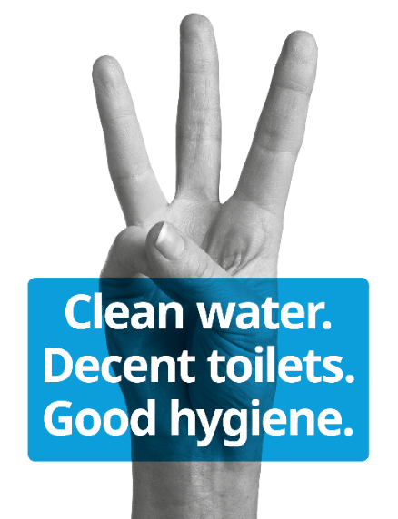
Notes:
WaterAid is an international not-for-profit, determined to make clean water, decent toilets and good
hygiene normal for everyone, everywhere within a generation.
Since we started in 1981, we’ve remained resolutely focused on tackling these three essentials that
transform people’s lives. Without all three, people can’t live dignified, healthy lives. With all three, they
can unlock their potential, break free from poverty, and change their lives for good. Children grow up
healthy and strong, women and men get to earn a living, whole communities start to thrive. It sounds
normal and it should be.
By inspiring people and sparking chain reactions we help deliver lasting change in what’s normal.
By working closely with partners internationally and on the ground in some of the toughest places
in the world, we help achieve widespread change. Millions of people have already taken control of
their lives and built better futures.

Slide 10
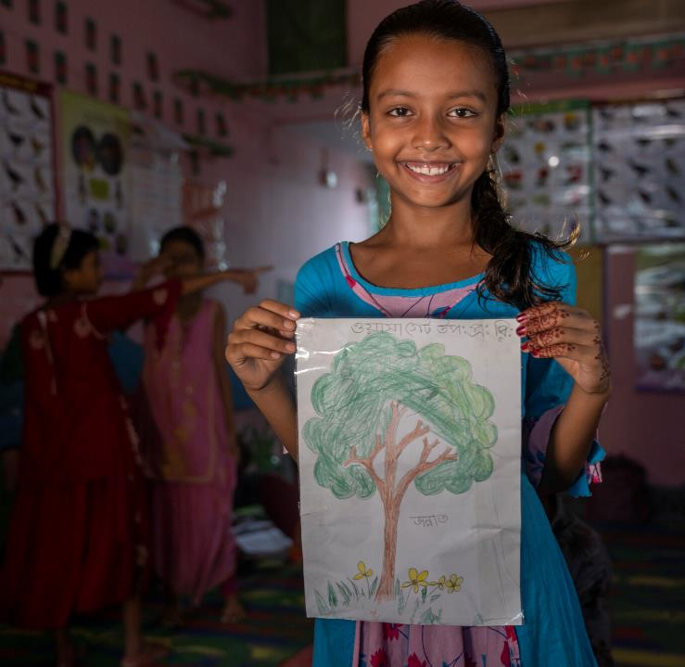
“The water we used to get before was less clean and smelled bad. Now, we have cleaner water which smells and tastes better. Drinking this water, we will be healthy and safe.”
Jannatul, 10, Bangladesh
WaterAid/ Laura Summerton
WaterAid/ Habibul Haque
Notes:
Jannatul, 10 years old from Jatrabari, Dhaka, Bangladesh
Jannatul is 10 years old. She lives in Jatrabari, in Bangladesh.
Jannatul’s community used to have no access to washing facilities to keep clean and struggled with dirty drinking water.
This often made the people in her community sick and unable to attend school or go to work.
However, now with the new community WASH facility, she has access to cleaner water and hygienic sanitation facilities. Her community is now much healthier as they are able to access clean drinking water and have good place to be able to keep clean.

Slide 11
How have WaterAid helped since 1981?
28.1 million people reached with clean water
28.8 million people reached with decent toilets
26.1 million reached with good hygiene
Notes:
Since 1981 we’ve directly reached:
28.1m people reached with clean water
28.8m people reached with decent toilets
26.1m reached with good hygiene
We count people as having been reached with good hygiene through better facilities, and through behaviour change activities when they have been exposed to those activities at least three times in a year.

Slide 12
Low cost and cost effective
Community contribution
Locally sourced and easily replaceable materials
Collaborative work with the community and local partners
Community empowerment
and ownership
Suitable to the environment
Notes:
WaterAid work with the participation of local communities and local partners. This means consulting communities, where people will identify, help build and contribute towards the cost of technologies that their community needs.
Working collaboratively is important as the communities and local partners will understand local issues, and we can provide the relevant skills and support so communities can set up, manage and maintain the project.
These projects will be low cost and cost effective, so the community can contribute to their projects. This empowerment leads to community ownership and responsibility.
The community will be able to use and look after the technologies themselves as they are well educated and trained in using and maintaining these technologies and the materials will be locally sourced and easily replaceable so repairs can be done quickly. Like rope pump.
Communities can have a trained mechanic and technologies will be suitable to the environment. For example a well is only suitable if there is a good supply of underground water.

Slide 13
Get involved with WaterAid
Fun activities like quizzes, games nights
Schools – our educational resources
Fundraising activities- bake sale
Campaign – sign a petition or lobby your MP
Volunteer – join the Speaker Network
Organise events with your faith group or service club
Notes:
Key Messages
Inspire the audience to get involved with fundraising and other activities:
This is just a selection of ideas - see wateraid.org/uk/get-involved

Slide 14
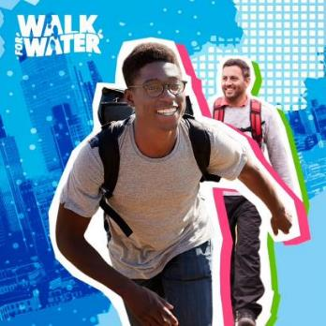
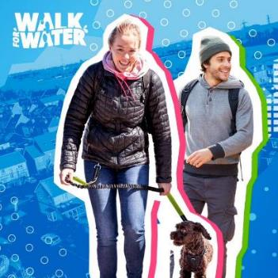
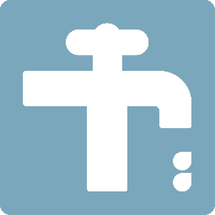
Walk for Water
How far will you Walk for Water?
This March, your steps will change lives for good
Sign up now:
walkforwater.wateraid.org
Notes:
Every day millions of women and children walk for miles to get clean, safe water. Walk for Water and raise funds so they no longer have to.
Challenge yourself to walk 4, 8 or 12km every day this March!
Choose your distance and walk it when and where you can, and raise funds for WaterAid.

Slide 15
The difference you can make £15 can buy a water supply distribution pipe in Zambia £50 can train one person to maintain a water pump in Nepal £500 can build a rainwater harvesting system for a family in Burkina Faso

Slide 16
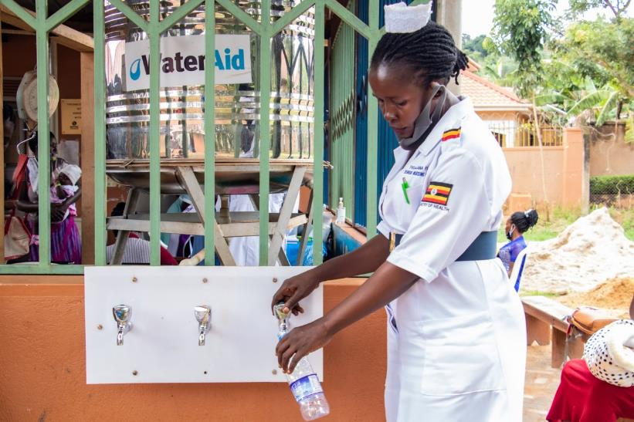
Thank you
WaterAid/ James Kiyimba
Notes:
Clean water, decent toilets and good hygiene are basic human rights. They should be a normal part of daily life for everyone, everywhere – but they aren't. That's why we're here. And thanks to our supporters like you, we’ve been able to reach even more people with WASH. Thank you for helping us transform peoples lives for the better. Here is one final story to leave with you today.
Tigalana Fidah, 44, senior nursing officer, getting safe drinking water from a water purifier provided by WaterAid, the water point is located at a busy children's immunisation centre, Ndejje Health Centre IV, Makindye Ssabagabo Municipality, Wakiso district, Uganda, May 2020.
“True there is a Covid-19 pandemic, but we should not forget that we still have other preventable diseases we have to fight, we have to continue with immunisation, HIV testing and family planning outreaches.”
Before, WaterAid implemented the WASH project in Ndejje Health Centre IV the situation was wanting. We did not have a tap water connection in the labour ward, also the sanitation facilities were not in a good state, and there were pit latrines shared between outpatients and expectant mothers. We did not have an incinerator or a placenta pit for proper medical waste disposal. We were practising open air burning of medical waste, though this is not recommended. The story is long; mothers had nowhere to bath, yet it is advised that a mother has to bath in the first 24 hours after delivery of her baby. Before WaterAid constructed these showers with water connection, mothers used to just go back home without bathing. The change
We are very grateful to WaterAid because we now have a new sanitation block with separate toilets and bathrooms for both male and female clients. Tap water and handwashing facilities in the labour ward have been reinstalled, and new bathrooms for postnatal mothers and health care workers have been constructed. We have two toilets and bathrooms in the postnatal wing, which are easy to access anytime of the day and night. Hygiene for the postnatal mothers and that of health workers has greatly improved. After getting these first-class toilet blocks from WaterAid, it has given us a challenge to improve our maternity and labour ward to match the standard of the sanitation facilities. For example, the new toilet floor is made of tiles, but the maternity ward floor is made of ordinary cement. As hospital administrators we have approved a budget this financial year to renovate the labour and maternity ward. We want tiles and walls repainted and the work has in fact commenced so as to meet the standards set by WaterAid. Disposal of medical waste was a challenge; we were still practising open air burning though this is not allowed by the ministry of health. After getting this standard incinerator we have no problem with proper waste disposal. Work without water Without water, sanitation and hygiene facilities at a health centre, my work as a midwife becomes very risky, especially when it comes to infection control. In surgical procedures, washing hands and cleaning of blood is a must and we need a lot of water to do this. We also have guidelines for infection control from the Ministry of Health that we follow but without water these cannot be met. Even though we have sanitisers, these are supposed to be used for simple disinfection. We always need easy access to water in health centres. WaterAid has also installed a safe drinking water system at the children’s immunisation centre where everyone comes to get drinking water. We have also acquired female friendly and accessible flush toilets and bathrooms which has a pathway for wheelchair users. For proper garbage management, we have someone in charge of collecting medical waste every morning and safely disposes of it. Looking at WASH holistically, the one thing that I feel needs improvement is to have additional drinking water purifiers. At the moment we only have one point, if a patient is at the outpatient department, it is far to walk to the immunisation area to get drinking water. People who come here for HIV/Aids treatment always need lots of water to take their drugs. How Covid-19 has affected work
The lockdown and suspension of public transport due to the spread of Covid-19 pandemic has greatly affected our work. Some of the health workers are not accommodated here at the health facility, so we resolved that they report to work twice a week, though they were supposed to work five days in a week. The only fuel left on the hospital budget is for use on immunisation outreaches. The few health workers who are accommodated at the health centre and those who report on duty are overloaded with work. True there is a Covid-19 pandemic, but we should not forget that we still have other preventable diseases we have to fight. We have to continue with immunisation, HIV testing and family planning outreaches. But we have integrated Covid-19 prevention messages in our day-to-day work. We take body temperatures every day we report on duty, we have also assigned someone at the hospital gate to ensure that anyone who enters the hospital premises is wearing a face mask, as well as washing his or her hands-on arrival.

